Slide 1
Agile & Scrum
3AGIL - Day 1

Slide 2
Course summary
Intro (15’)
Agile Methodologies (1h15)
Scrum (4h)
Cross-functional teams & Knowledge workers (1h15)
Knowledge Check (15’)

Slide 3
Quick Agile Story
1991
1994
1995
1996
1997
2001
2005
2009
2011
SCRUM
Agile Manifesto
RAD
(Rapid Application Development)
Crystal Clear
&
XP
(Extreme Programming)
PM Declaration of Interdependence
Guide to Agile Practices
UP
(United Process)
DSDM
(Dynamic Systems Development Method)
SCM
(Software Craftsmanship Manifesto)
FDD
(Feature Driven Development)
Notes:
Scrum and XP existed BEFORE the Agile Manifesto

Slide 4
Agile Methodologies

Slide 5
The Manifesto for Agile Software Development
Individuals and interactions over processes and tools
Working software over comprehensive documentation
Customer collaboration over contract negotiation
Responding to change over following a plan
Notes:
Tools and processes are important, but it is more important to have competent people working together effectively.
Good documentation is useful in helping people to understand how the software is built and how to use it, but the main point of development is to create software, not documentation.
A contract is important but is no substitute for working closely with customers to discover what they need.
A project plan is important, but it must not be too rigid to accommodate changes in technology or the environment, stakeholders' priorities, and people's understanding of the problem and its solution.

Slide 6
Agile software development principles (1/2)
1. Customer satisfaction by early and continuous delivery of valuable software.
2. Welcome changing requirements, even in late development.
3. Deliver working software frequently (weeks rather than months).
4. Close, daily cooperation between business people and developers.
5. Projects are built around motivated individuals, who should be trusted.
6. Face-to-face conversation is the best form of communication (co-location).
Notes:
the needs and priorities of the customer may change over time, the development team should be flexible and responsive to these changes.

Slide 7
Agile software development principles (2/2)
7. Working software is the primary measure of progress.
8. Sustainable development, able to maintain a constant pace.
9. Continuous attention to technical excellence and good design.
10. Simplicity—the art of maximizing the amount of work not done—is essential.
11. Best architectures, requirements, and designs emerge from self-organizing teams.
12. Regularly, the team reflects on how to become more effective, and adjusts accordingly.

Slide 8
Agile Principles appropriation exercise (45-60’)
For each Agile Principle, take some time to reflect on them, and explain its advantages :
For the company
For the team
For the individual
For the clients
Sometimes, reasons overlap : keep digging !
Notes:
1st Agile Principle: "Our highest priority is to satisfy the customer through early and continuous delivery of valuable software." For the company: Increased adaptability and responsiveness to change For the team: Improved collaboration and teamwork For the individual: Greater autonomy and ownership For the clients: Enhanced satisfaction and value delivery
2nd Agile Principle: "Welcome changing requirements, even late in development. Agile processes harness change for the customer's competitive advantage." For the company: Improved competitiveness and market responsiveness For the team: Greater flexibility and adaptability For the individual: Enhanced learning and growth opportunities For the clients: Greater alignment with changing needs and preferences
3rd Agile Principle: "Deliver working software frequently, from a couple of weeks to a couple of months, with a preference to the shorter timescale." For the company: Increased efficiency and speed of delivery For the team: Improved focus and accountability For the individual: Greater sense of accomplishment and progress For the clients: Enhanced visibility and transparency of the development process
4th Agile Principle: "Business people and developers must work together daily throughout the project." For the company: Improved alignment and integration of business and technical goals For the team: Enhanced collaboration and communication For the individual: Greater understanding and appreciation of the broader context and goals For the clients: Improved customer experience and satisfaction
5th Agile Principle: "Build projects around motivated individuals. Give them the environment and support they need, and trust them to get the job done." For the company: Increased motivation and retention of top talent For the team: Improved morale and job satisfaction For the individual: Greater sense of ownership and accountability For the clients: Enhanced quality and reliability of the software
6th Agile Principle: "The most efficient and effective method of conveying information to and within a development team is face-to-face conversation." For the company: Improved communication and collaboration For the team: Enhanced understanding and clarity For the individual: Greater opportunities for personal and professional growth For the clients: Improved responsiveness and customer service
7th Agile Principle: "Working software is the primary measure of progress." For the company: Improved focus on delivering value and meeting customer needs For the team: Enhanced accountability and performance For the individual: Greater sense of accomplishment and progress For the clients: Enhanced satisfaction and value delivery
8th Agile Principle: "Agile processes promote sustainable development. The sponsors, developers, and users should be able to maintain a constant pace indefinitely." For the company: Improved long-term sustainability and scalability For the team: Enhanced work-life balance and mental health For the individual: Greater long-term career satisfaction and development For the clients: Enhanced long-term value and satisfaction with the software
9th Agile Principle: "Continuous attention to technical excellence and good design enhances agility." For the company: Improved quality and reliability of the software For the team: Enhanced learning and growth opportunities For the individual: Greater pride in work and personal development For the clients: Enhanced satisfaction and value delivery
10th Agile Principle: "Simplicity--the art of maximizing the amount of work not done--is essential." For the company: Increased efficiency and speed of delivery For the team: Improved focus and clarity For the individual: Greater autonomy and ownership For the clients: Enhanced satisfaction and value delivery
11th Agile Principle: "The best architectures, requirements, and designs emerge from self-organizing teams." For the company: Improved adaptability and innovation For the team: Enhanced collaboration and teamwork For the individual: Greater sense of ownership and accountability For the clients: Enhanced satisfaction and value delivery
12th Agile Principle: "At regular intervals, the team reflects on how to become more effective, then tunes and adjusts its behavior accordingly." For the company: Improved continuous improvement and learning culture For the team: Enhanced reflection and growth opportunities For the individual: Greater sense of ownership and accountability For the clients: Enhanced satisfaction and value delivery

Slide 9
Case Study (60’)
Mayden - See PDF
What challenges did the company face ? What impact did it have on their business ?
What opportunity presented itself ? How was it embraced ?
What was the team reaction ?
What are the keys elements to success in this transition ?
Can you identify 3 types of companies for which Scrum wouldn’t apply as easily ?
What would be a good definition of “Waterfall” according to you ? Pick a company that you believe works in waterfall and try to outline and design their processes.
Notes:
https://docs.google.com/document/d/1XbKzQHw7RNNImdIGgTD9ipiLkvtcTk7jcyDTayoAj6k/edit

Slide 10
Agile vs Waterfall Methodology
Agile | Waterfall
Emphasizes flexibility and adaptability | Follows a linear and sequential approach
Uses an iterative and incremental approach | Emphasizes a clear and defined plan
Prioritizes customer satisfaction and delivery of value | Prioritizes following the plan and minimizing changes to the scope of the project
Involves continuous collaboration and communication with the customer | Involves less collaboration and communication with the customer
Allows for changes to the scope of the project
Notes:
Overall, the main difference between agile and waterfall methodologies is their approach to project management. Agile methodologies prioritize flexibility, adaptability, and customer satisfaction, while waterfall methodologies prioritize a clear and defined plan and minimizing changes to the scope of the project. Both approaches have their own strengths and can be appropriate for different types of projects.
Waterfall methodologies are well-suited for projects that have a clear and well-defined scope, where the requirements are understood up front and are not likely to change significantly during the development process. This approach is particularly useful when the project involves a high level of complexity or risk, as it allows for careful planning and helps to minimize the potential for changes or disruptions.

Slide 11
Waterfall strengths & weaknesses
Strengths | Weaknesses
Clearly defined roles and responsibilities | Inflexible and not well-suited for projects with changing requirements
Detailed planning process up front | Limited opportunities for customer collaboration and feedback
Easy to understand and communicate | Limited ability to adapt to changes in the project or the business environment
Well-suited for projects with a clear and well-defined scope and requirements that are unlikely to change significantly | Not well-suited for projects with high levels of uncertainty or risk, as there is little room for iteration or adaptation
 | Can be time-consuming and resource-intensive, as the planning process up front is thorough and detailed

Slide 12
Agile Methodologies Strengths & Weaknesses
Strengths | Weaknesses
Flexible and adaptable | Can be challenging for organizations that are not used to working in an agile way, as it requires a different approach to project management and a different set of skills and mindsets
Allows for changes to the scope of the project | May require more frequent communication and collaboration with the customer, which can be time-consuming
Prioritizes customer satisfaction and delivery of value | May require more frequent reassessment of priorities and goals, which can be challenging for some organizations
Involves continuous collaboration and communication with the customer | May not be well-suited for projects with a clear and well-defined scope and requirements that are unlikely to change significantly
Uses an iterative and incremental approach, which allows for iteration and adaptation
Well-suited for projects with high levels of uncertainty or risk, as it allows for rapid iteration and adaptation

Slide 13
Scrum

Slide 14
Introduction to Scrum
Framework : set of guidelines or a structure that helps to organize and guide the work of a particular system or process
Defined in The Scrum Guide (Download it and read it thoroughly !)
Better way of team collaboration for solving complex problems
Scrum is defined by its Roles, Events and Artifacts
As well as its three pillars and five values
Notes:
Scrum guide : https://scrumguides.org/

Slide 15
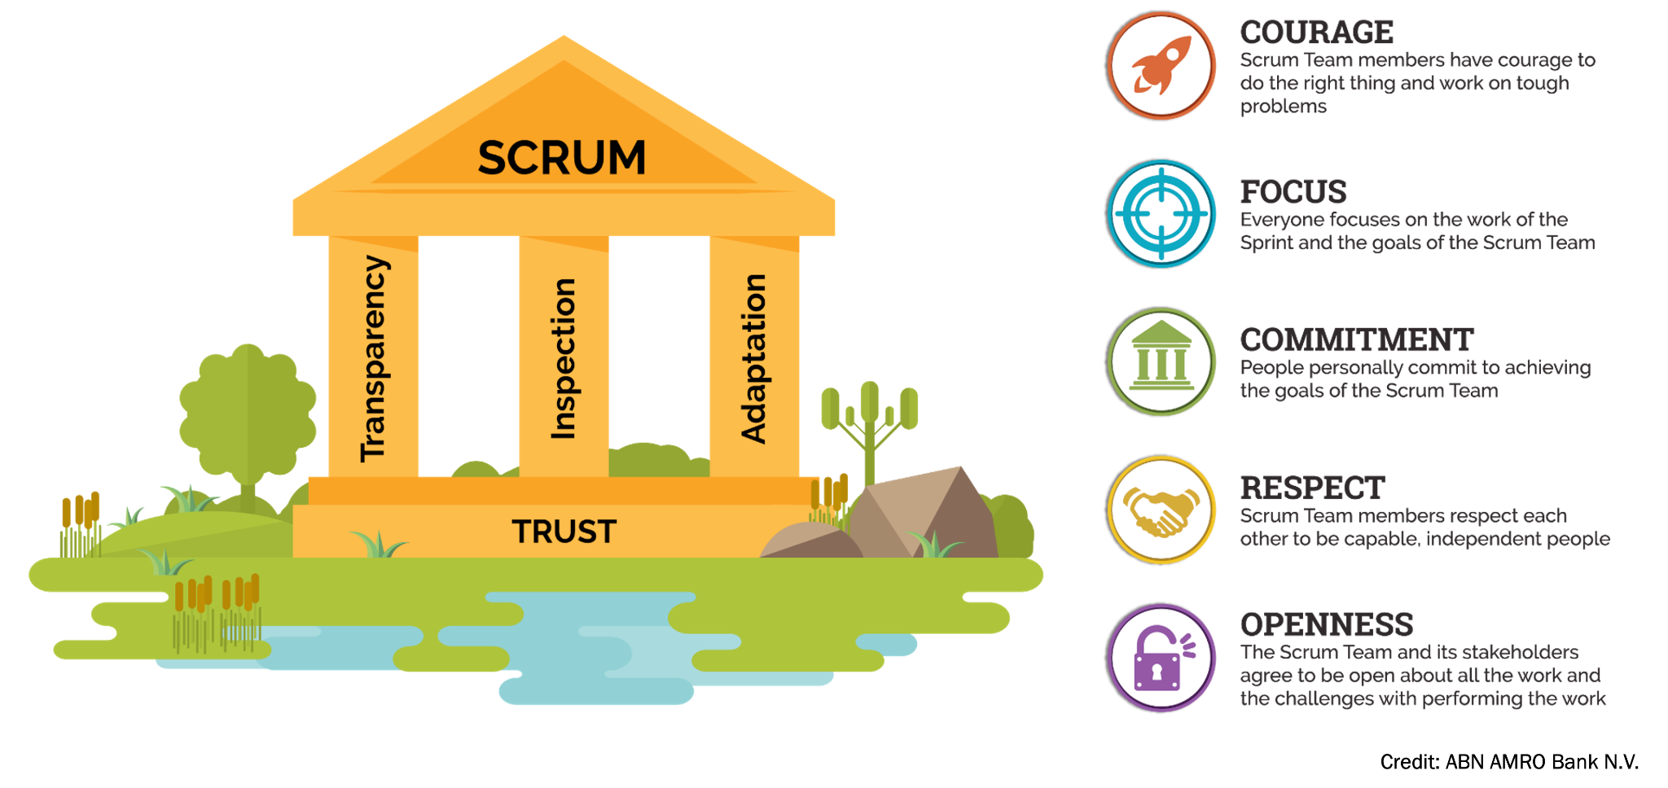
Pillars & Values
Notes:
Transparency means that the progress, status, and results of the development process should be visible to all stakeholders. This allows for a clear understanding of what has been accomplished, what work remains to be done, and how well the team is progressing towards its goals.
Inspection means that the team should regularly review and assess its progress and the quality of its work. This helps to identify any problems or obstacles that may be hindering the team's progress, and allows for early corrective action to be taken.
Adaptation means that the team should be flexible and responsive to change. This means that the team should be willing and able to adjust its plans and processes as needed in order to respond to changing circumstances or new information.
The values of Scrum are intended to support the successful implementation of these pillars.
Commitment means that team members are fully dedicated to the success of the project and are willing to work together to overcome challenges.
Courage means that team members are willing to take risks and try new things, even in the face of uncertainty.
Focus means that team members are able to maintain a clear and singular focus on the goals of the project, rather than being distracted by other priorities.
Openness means that team members are willing to share ideas, thoughts, and concerns, and to work collaboratively towards a common goal.
Respect means that team members are respectful of one another and of the work that they are doing, and are willing to support and learn from one another.

Slide 16



Scrum Roles
Scrum Master
Product Owner
Dev Team
Facilitates the Scrum process | Represents the interests of stakeholders | Delivers working software at the end of each sprint
Ensures that the Scrum process is being followed correctly | Defines the goals and priorities for the project | Self-organizing and self-managing
Helps the team stay focused and on track | Creates and maintains the product backlog | Made up of cross-functional members with the skills and expertise needed to complete the work
Removes obstacles that may be preventing the team from making progress | Communicates the vision and goals of the project to the team | Responsible for completing all of the tasks required to deliver a working product
Ensures that the team is following the values and principles of Scrum | Ensures that the team is working on the most valuable items

Slide 17




Scrum Ceremonies
What are we doing?
How did we do ?
Sprint Planning
Sprint Review
Daily Scrum
Sprint Retrospective
What will we do?
What did we do?
SPRINT

Slide 18
Research time ! (20’)
How long should a Sprint last ?
Who should be present during each of these ceremonies ?
Who should lead each ceremony?
What happens if we run out of time during a ceremony ?
What are good ways to run a Sprint Planning ?
What are the key differences between Sprint Review and Sprint Retrospective ?

Slide 19



Scrum Artifacts
The plans and work which are transparent and can be inspected allowing for future adaptation;
Each artifact has its own Commitment which helps the team understand if they are making progress
Product Backlog
Sprint Backlog
Increments
Product Goal - the target the team plans against
Sprint Goal - the single objective of the Sprint
Commitments
Definition of Done - the description of what it takes for an Increment to be considered complete

Slide 20
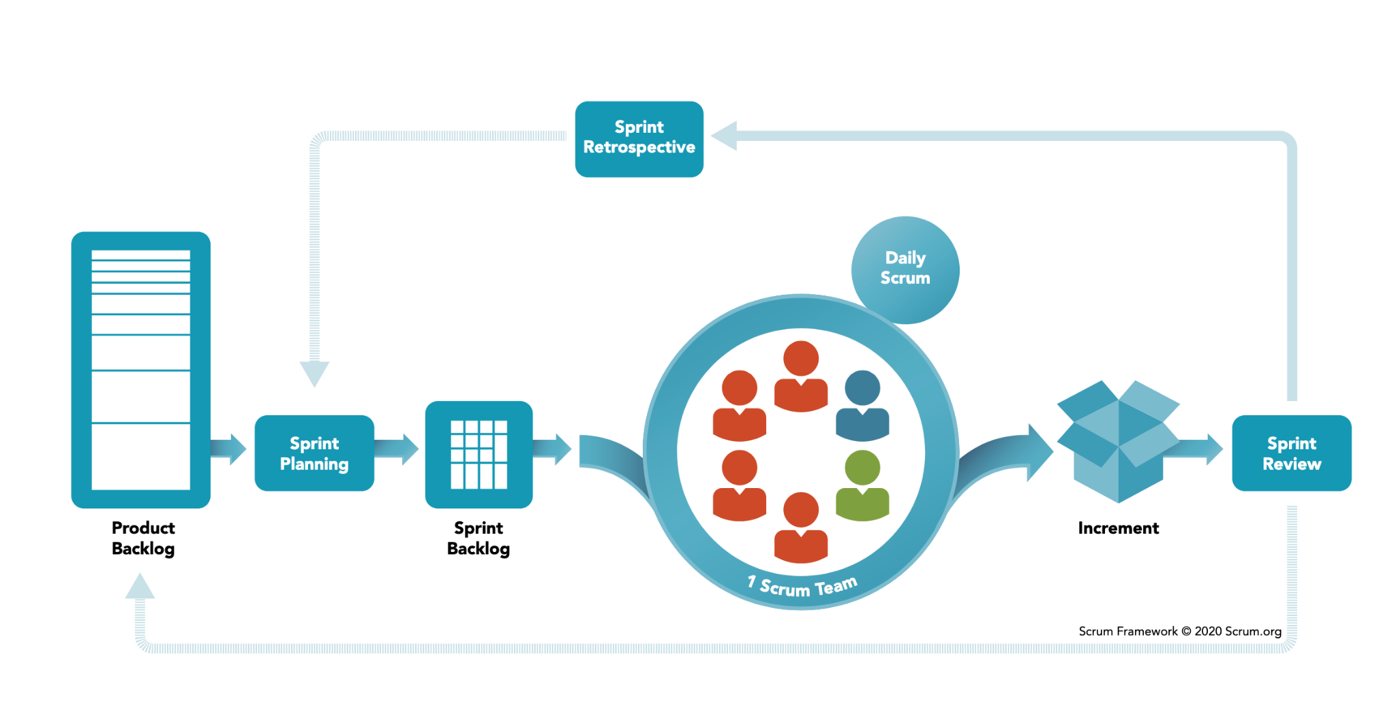
Overview

Slide 21
Advantages of Scrum
Improved communication and collaboration
  Team members work closely together, sharing ideas and feedback
  Regular meetings and reviews help to ensure that everyone is on the same page
Greater flexibility and adaptability
  The team can adjust its plans and priorities based on new information or changing circumstances
  The focus is on delivering working software, rather than following a rigid plan
Faster delivery of working software
  The team delivers working software at the end of each sprint
  This allows for faster feedback and iteration
Enhanced customer satisfaction
  The team is able to deliver value to the customer more quickly
  The customer is able to provide feedback and shape the direction of the product

Slide 22
Best practices for Scrum
Emphasis on self-organization and self-management
  The Development Team is responsible for determining how best to complete the work that has been assigned to them
  This promotes ownership and accountability
Use of a collaborative approach to problem-solving
  Team members work together to identify and solve problems
  This promotes teamwork and cooperation
Regular inspection and adaptation
  The team regularly reviews its progress and adjusts its plans as needed
  This helps to ensure that the team is always working on the most valuable items and is able to respond to changing circumstances

Slide 23
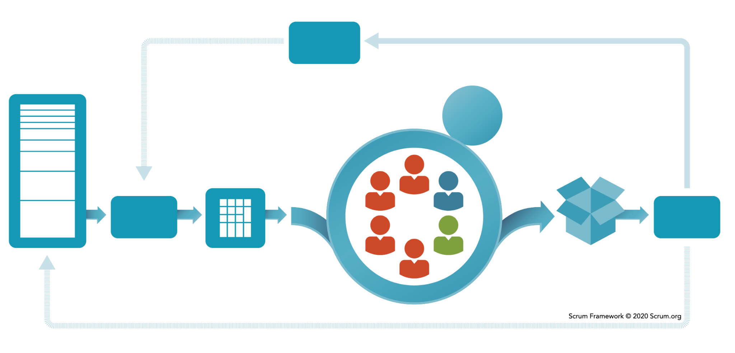
Fill in the blanks !
4
A
2
c
a
1
D
b
3
B
C
Notes:
Sprint Planning
Daily Scrum
Sprint Review
Sprint Retrospective
Product Backlog
Sprint Backlog
Increment
Scrum team
Product owner
Scrum master
Dev team

Slide 24
Case Study
Scrum outside the development industry : the case of Saab : https://conceptsandbeyond.com/wp-content/uploads/2022/11/Owning-the-Sky-with-Agile.pdf
What was the problem that the team was trying to solve in the case study?
What were the potential solutions that the team considered and why were they chosen?
What were the main challenges that the team faced during the implementation of their chosen solution?
How did the team evaluate the success of their solution?
What lessons or takeaways can be learned from the case study that could be applied to similar problems in the future?
Notes:
https://conceptsandbeyond.com/wp-content/uploads/2022/11/Owning-the-Sky-with-Agile.pdf

Slide 25
Scrum Certifications & Prep
Scrum Master Certification
Product Owner Certification
Scrum Developer Certification…
READ THE SCRUM GUIDE

Slide 26
Practice exam ! (30’)
Go here : https://www.scrum.org/open-assessments
Choose “Scrum Open”
You got 30’
Open book exam

Slide 27
Knowledge workers
& Cross-functional teams

Slide 28
Cross-functional teams
Cross-functional teams are groups of people with diverse skills and expertise who work together to achieve a common goal.
These teams are composed of members with different functional areas, such as engineering, marketing, and sales.
The goal of a cross-functional team is to bring together different perspectives and skills to solve problems, make decisions, and deliver results more effectively.
Some advantages of cross-functional teams include increased efficiency, improved communication and collaboration, and enhanced creativity and innovation.
Notes:
Ideally :
Link this to dev-team in scrum
Have them think of examples of cross functional teams in and out of the industry (DevOps teams, sure, but also : electrician & plumber ?)

Slide 29
Challenges & Best-practices
One challenge of cross-functional teams is that members may have different goals, priorities, and ways of working.
To overcome these challenges, it is important to establish clear roles and responsibilities, as well as effective communication and collaboration practices.
Some best practices for cross-functional teams include setting common goals and objectives, fostering open communication and transparency, and providing opportunities for team members to learn from each other.

Slide 30
Knowledge workers & roles
Knowledge workers are individuals who use their knowledge, skills, and expertise to add value to an organization.
They often work in complex and dynamic environments, and rely on their ability to think critically and solve problems.
Cross-functional teams can be especially effective in supporting knowledge workers, as they provide a diverse range of skills and expertise to draw upon.
By working together, knowledge workers and cross-functional teams can effectively tackle complex problems and deliver high-quality solutions.
Notes:
Outline that THEY are bound to become knowledge workers, or to manage KW.
Outline that their role is to rely and surround themselves with solid KW.
Point out that a good manager is someone that is okay with being surrounded with someone that is more knowledgeable than him on some topics.

Slide 31
Knowledge Check (10’)
Notes:
https://docs.google.com/document/d/1sAo9tAEEuujaGwNUIiMyxh4qpyjVxaZvt4XwJJCy3xw/edit

